Slide 1
Team 5:
Multidisciplinary Optimization –
Formulations and Mehtods
Alex Beyer, Ella Vincente
Department of Mechanical Engineering
University of Maryland
College Park, MD 20742-3035
Email: {abeyer, gvincente}@umd.edu

Slide 2
Multidisciplinary Motivations
Many common problems involve optimizing across different fields
Structure Design
Economics
Robotics & Controls
How do we optimize these problems if they involve information and constraints across multiple distinct fields?
How do we solve simpler problems?
Notes:
Optimization problems are a common feature of many different branches of science
However, oftentimes we find ourselves having to optimize across multiple domains at once, for example:
Structure Design often involves optimizing for everything from mechanical properties of building materials and environmental impact to the economics of the project
Many robotics problems require multiple systems interacting to solve problems while trying to optimize for things like speed, power consumption and accuracy
BUT – how do we handle solving these disparate problems separately? In many cases we end up with multiple distinct sets of equations, all with unique constraints, which only share some of their variables. The naïve approach is to try and extend methods we’ve used before for simpler problems, however this becomes incredibly difficult as the number of variables and constraints increases. In practice this means we need to approach these problems carefully, breaking them down in ways that make the optimization easier – this is where multidisciplinary optimization comes in!

Slide 3
1st-Half Project Topics
~~~PROBLEM FORMULATION PAPER HERE?~~~

Slide 4
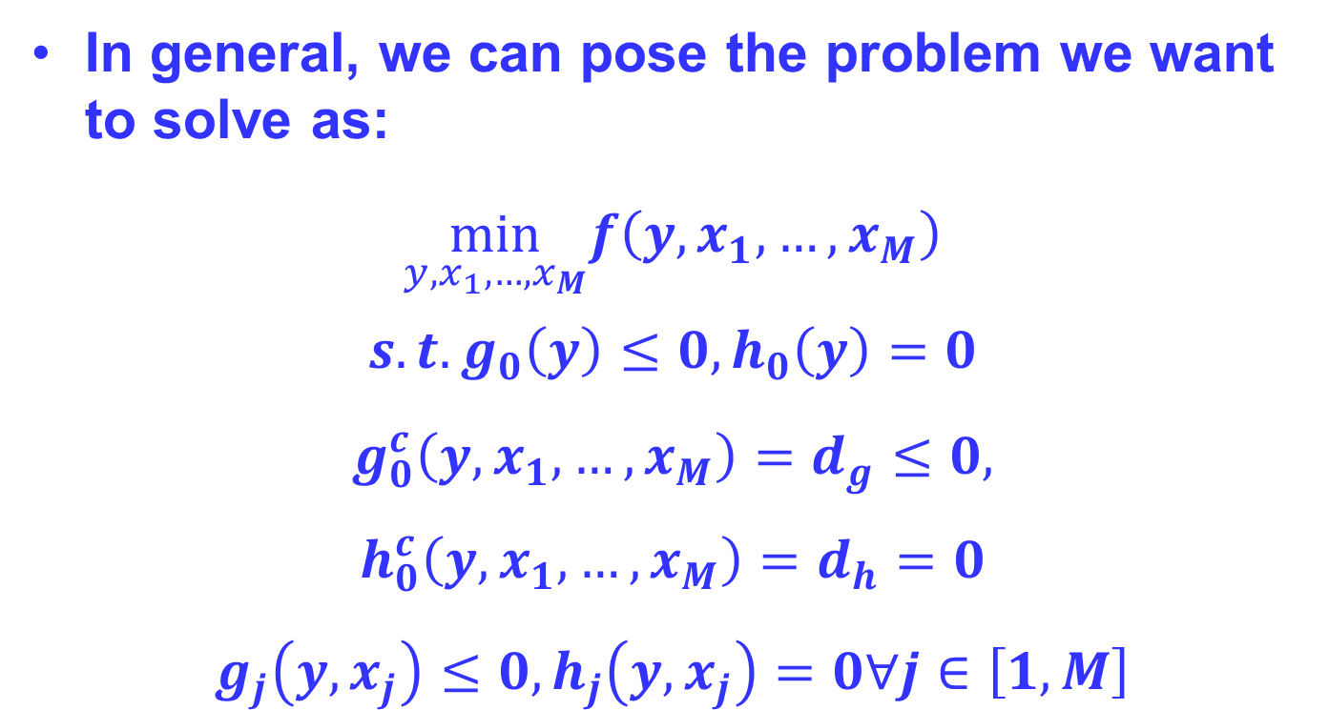
MDO: Problem Statement
In general, we can pose the problem we want to solve as:
$$\min_{y,x_{1},…,x_{M}}f\left(y,x_{1},…,x_{M}\right)$$
$$s.t. g_{0}\left(y\right)≤0, h_{0}\left(y\right)=0 \\ g_{0}^{c}\left(y,x_{1},…,x_{M}\right)=d_{g}≤0, \\ h_{0}^{c}\left(y,x_{1},…,x_{M}\right)=d_{h}=0 \\ g_{j}\left(y,x_{j}\right)≤0, h_{j}\left(y,x_{j}\right)=0∀j∈\left[1,M\right]$$
System Constraints
Consistency Constraints
Disciplinary Constraints
Notes:
Before we can start classifying problems and discussing approaches it’s helpful for us to determine a standard form to pose these problems
Note here that all the functions f, g and h are vector valued
Our goal is to minimize a set of functions f which depends on the system level variables y and may depend on some or all of the disciplinary variables x1,…,M
In general, we can split our constraint functions into two types: inequality based (g) and equality based (h)
And further split them into three types: system level constraints which depend only on system level constraints, consistency constraints which ensure that optimizing one domain doesn’t lead to infeasible solutions in another domain and can depend on any variables in the problem, and finally the disciplinary constraints which are functions of only variables in that discipline and the system level constraints
A few notes:
1 – in some cases we refer to the value of the consistency constraints as the discrepency d
2 – If you read the papers (which I suggest you do if you do MDO) some of them make a distinction between the disciplinary state variables which are not optimized, s, and disciplinary design variables which are, x. In this presentation we combine both into the vector xj
3 – functions are variables subscripted with a zero are system level, while nonzero subscripts refer to the discipline the function is a part of

Slide 5
MDO: Problem Statement
Introduce example here?

Slide 6
MDO: Solver Setup
Before setting up an optimizer we need to decide on an approach:
Do we solve the problem all at once or break it into smaller problems?
How do we optimize system level variables?
How do we optimize discipline specific variables?

Slide 7
MDO: Solver Terminology
Disciplinary Analyzers
Determine residuals in equations of state
Disciplinary Evaluators
Zero residuals of equations of state
Disciplinary Optimizers
Use Analyzers and Evaluators to optimize a set of equations subject to constraints
System Analyzers
Solve coupling variables using Disciplinary Analyzers
System Optimizers
Call the other tools to solve the MDO problem
Terminology, diagrams originally from [1]

Slide 8
MDO: Solver Setup
Single Level Optimizers
Use a single system level optimizer to cover every discipline
Multilevel Optimizers
Involve multiple discipline level optimizers coordinated by a system level optimizer
Terminology, diagrams originally from [1]

Slide 9
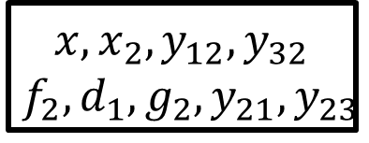
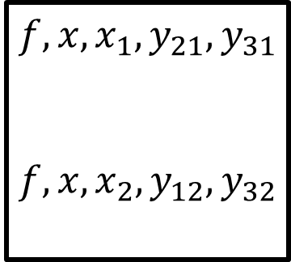
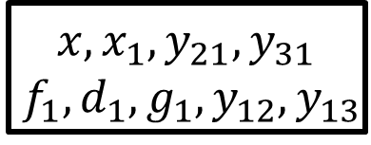
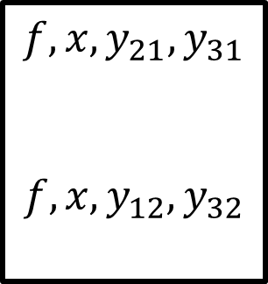
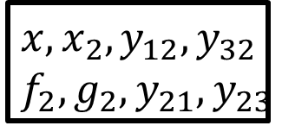
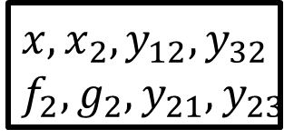
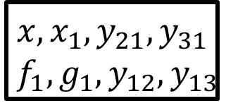
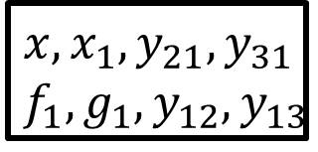
MDO: Solver Setup
Simplified Single Level System:
System Optimizer
Disciplinary Evaluators
$$f,x,x_{1},y_{21},y_{31}$$
$$f,x,x_{2},y_{12},y_{32}$$
$$x,x_{1},y_{21},y_{31}$$
$$f_{1},g_{1},y_{12},y_{13}$$
$$x,x_{2},y_{12},y_{32}$$
$$f_{2},g_{2},y_{21},y_{23}$$
Simplified Multilevel System:
System Optimizer
Disciplinary Evaluators
Disciplinary Optimizers
$$f,x,y_{21},y_{31}$$
$$f,x,y_{12},y_{32}$$
$$x,x_{1},y_{21},y_{31}$$
$$f_{1},d_{1},g_{1},y_{12},y_{13}$$
$$x,x_{1},y_{21},y_{31}$$
$$f_{1},g_{1},y_{12},y_{13}$$
$$x,x_{2},y_{12},y_{32}$$
$$f_{2},d_{1},g_{2},y_{21},y_{23}$$
$$x,x_{2},y_{12},y_{32}$$
$$f_{2},g_{2},y_{21},y_{23}$$
Terminology, diagrams originally from [1]

Slide 10
MDO: Solver Setup
Simultaneous Analysis and Design (SAND)
A system optimizer determines the system, disciplinary and coupling variables all at once
Nested Analysis and Design (NAND)
Limits system optimizers to only finding disciplinary variables, including an analyzer to find coupling variables
Terminology, diagrams originally from [1]

Slide 11
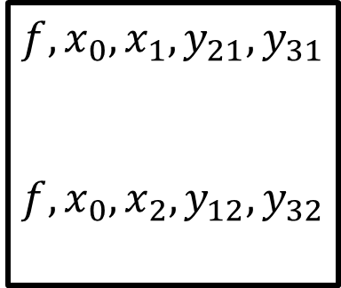
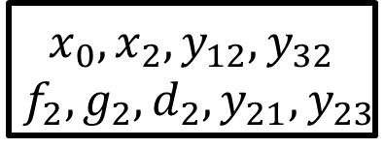
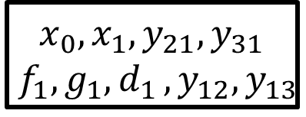
MDO: Solver Setup
Simplified Single Level SAND/SAND System:
System Optimizer
Disciplinary Evaluators
$$f,x_{0},x_{1},y_{21},y_{31}$$
$$f,x_{0},x_{2},y_{12},y_{32}$$
$$x_{0},x_{1},y_{21},y_{31}$$
$$f_{1},g_{1}{,d}_{1},y_{12},y_{13}$$
$$x_{0},x_{2},y_{12},y_{32}$$
$$f_{2},g_{2},d_{2},y_{21},y_{23}$$
Simplified Multilevel NAND/NAND System:
System Optimizer
Disciplinary Evaluators
Disciplinary Optimizers
$$f,x,y_{21},y_{31}$$
$$f,x,y_{12},y_{32}$$
$$x,x_{1},y_{21},y_{31}$$
$$f_{1},d_{1},g_{1},y_{12},y_{13}$$
$$x,x_{1},y_{21},y_{31}$$
$$f_{1},g_{1},y_{12},y_{13}$$
$$x,x_{2},y_{12},y_{32}$$
$$f_{2},d_{1},g_{2},y_{21},y_{23}$$
$$x,x_{2},y_{12},y_{32}$$
$$f_{2},g_{2},y_{21},y_{23}$$
Terminology, diagrams originally from [1]

Slide 12
MDO: Solver Setup
Terminology, diagrams originally from [1]

Slide 13
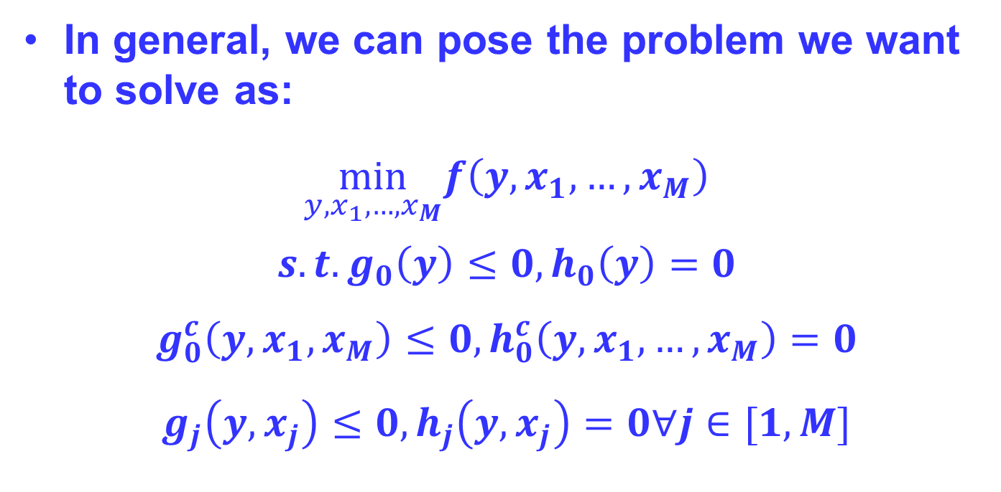
MDO: Optimization Approach
In general, we can pose the problem we want to solve as:
$$\min_{y,x_{1},…,x_{M}}f\left(y,x_{1},…,x_{M}\right)$$
$$s.t. g_{0}\left(y\right)≤0, h_{0}\left(y\right)=0 \\ g_{0}^{c}\left(y,x_{1},x_{M}\right)≤0,h_{0}^{c}\left(y,x_{1},…,x_{M}\right)=0 \\ g_{j}\left(y,x_{j}\right)≤0, h_{j}\left(y,x_{j}\right)=0∀j∈[1,M]$$
System Constraints
Consistency Constraints
Disciplinary Constraints

Slide 14
Sources
[1] Balling, R. J., & Sobieszczanski-Sobieski, J. (1996). Optimization of Coupled Systems - A critical overview of approaches. AIAA Journal, 34(1), 6–17. https://doi.org/10.2514/3.13015
[2]Cramer, E. J., Dennis, Jr., J. E., Frank, P. D., Lewis, R. M., & Shubin, G. R. (1994). Problem formulation for multidisciplinary optimization. SIAM Journal on Optimization, 4(4), 754–776. https://doi.org/10.1137/0804044
[3]Tosserams, S., Etman, L. F., & Rooda, J. E. (2009). A classification of methods for distributed system optimization based on formulation structure. Structural and Multidisciplinary Optimization, 39(5), 503–517. https://doi.org/10.1007/s00158-008-0347-z

Slide 15
1st Half Project Preferences: Assignment Due by Feb 16 @ Noon

Slide 16
1st-Half Project Assignment
For each project topic, a couple of references are provided
Reference papers provided are just what I found: may not be the most appropriate for a tutorial
Give a tutorial on background, how the method work, main issues, example(s), etc.
From the audience point of view: “What are the TAKEAWAYS?
Make your presentation self-contained and NOT too technical (too many math eqs.): Include simple concepts, figures, flowchart, etc. to communicate your points efficiently, in 25 minutes!

Slide 17
1st-Half Project Assignment (cont’d)
For your presentation:
Make sure your slides give a connected and meaningful story: contents of the slides must be connected together
Make your presentation interesting – e.g., good presentation should engage audience, raise questions
Do not overload your slides with too much information or too much text with small fonts – use fonts >18 pt
You’re expected to have a SINGLE “Insightful Q/A”:
Should be related to and already covered (directly or indirectly) in your tutorial
Should be related to a fundamental (non-trivial) concept on the assigned topic
I may use your Q&A as part of the course material for Exam II!
Prepare a (written) verbatim transcription of your talk for each slide in the “Notes Page” of Power Point
Use THIS template for your tutorial slides!

Slide 18

1st-Half Project Assignment (cont’d)
For your presentation:
If you use a picture/fig/etc. from the literature, e.g., web, paper: Give the Source
Order of presentations:
TBA
Will reverse the order for second half!
Will set up a Discussion in ELMS for your submission
Source of pictures/eqs, etc[Courtesy of …]
Or if it is from web:
provide the access link and the “last
date of your access”
Or, you may provide a ref number: e.g., [5] below the fig and then list full information of the ref in the last slide: “Cited References”
[Note: I do pay attention to these details, so please Be Careful!]

Slide 19
Do’s and Don’ts
Do’s:
Prepare a self-contained (as much as possible) TUTORIAL
Use large fonts (> 18pt fonts) in your slides
If you use fig, eq., etc. from literature, do give proper credit (full citation)
Provide an insightful question and answer (Q&A):
One slide for Question and next slide with your Answer
Q/A should give the most important takeaway from your talk
Have a coherent—logically and consistently ordered slides and presentation -- basically a useful tutorial of assigned topic in 25 minutes!

Slide 20
Do’s and Don’ts
Don’ts:
Don’t overload your slides w/ TOO much information, small fonts, unclear/hazy figs, many eqs, …
Don’t make your talk too difficult to follow or too trivial
Don’t make your talk longer or shorter than allotted time – carefully plan your talk
Don’t include too many slides
DO NOT procrastinate completion of this project assignment!

Slide 21
Rubrics
1st half project is graded based on its “Quality”:
Excellent: 90% and above
Good: If 80% and above
Average: If 70% and above
Fair: If 60% and above
Poor: If less than 60%
Quality is assessed based on: tutorial nature of presentation, presentation creativity, neatness of delivery, insightful Q&A, and basically how well the instructions are followed!

Slide 22
Suggested Contents
Start your slides with
Cover page: title, name, course number, date
Some suggested contents – you might have a better idea on this, which would be great:
1. Motivation/background
2. Objective
3. approach
4. Example(s) – simple and engineering applications
5. Insightful Q&A
6. Conclusions -- highlights, takeaway
7. References

Slide 23
Feasibility Robust Optimization
Sample Example Presentations
from a Previous Semesters

Slide 24
What is Robust Optimization?
Optimizes performance of a design, as well as reducing its sensitivity to variations.
Historical background:
Robustness: Reducing effects of variations in parameters and variables without controlling the variation.
“Feasibility Robustness,” and “Objective Robustness,” were introduced by Parkinson, et. al., in 1993.
Notes:
Robust design (parameter design) was first introduced by Taguchi. The premise is that parameters, both controlled and uncontrolled, will vary.
The objective of this concept of “robust design” is to minimize the effects of this parameter variation on the performance of the design (reduce the sensitivity of a design). By doing this, there is little need for the designer to devise corrective measures when the variability exist.
Variability is defined in terms of tolerances which bracket the variation of fluctuating quantities. (i.e., gives upper and lower limits on the expected deviations of uncertain quantities about their nominal values)
Further, in 1993, Parkinson introduced the terms objective robustness and feasibility robustness to refer to robustness with respect to objective and constraint functions in an optimization problem.
Objective robustness (can be single/multi-objectives) focuses on that objective function(s) is minimum and remains within an acceptable bound when design variables vary. In this case, sensitivity measure is based on “Two-sided” sensitivity region.
Feasibility robustness can be achieved when inequality constraint values are always feasible regardless of variations of design parameter. “One-sided” sensitivity region is considered for the feasibility robustness. In other words, limiting the constraint deviation along one direction will be the only interest.
One thing to note is that feasibility robust optimization is concerned only within inequality constraints. This is because, it is so difficult to guarantee the equality constraints will always be satisfied under the variations of parameters (delta P).
Just for additional information:
Taguchi’s methodology was depending on direct experiment. Further his concept was implemented using nonlinear programming.

Slide 25
Feasibility and Objective Robustness
Feasibility
Objective
Feasible region
Design Parameter p₂
Traditional Optimum
New optimum
f (x, p)
Robust Optimum
Optimum
Design Parameter p₁
Design variable x
Notes:
This slide illustrates the difference between feasibility and objective robustness.
In the first figure (feasibility), a new optimum is found. By using this optimum, slight changes in the values of the constraint function will not result in an infeasible solution.
The second figure illustrates objective robustness. While the traditional optimum is the true minimum, slight variation in x and p will result in a much worse design. By using the robust optimum, a slight variation in x and p will only result in a slight variation in f.

Slide 26
Why Feasibility Robust Optimization?
Traditional design optimization - no variation in design variables x and parameters p.
Variations in x and p:
Cannot be controlled and avoidable entirely.
Lead to violations of constraints.
“Safety factor” not always enough.
Real-world design parameters follow probability distributions:
Normal distribution, Weibull distribution, Poisson distribution, etc.
Notes:
Traditional design optimization assumes that parameters and variables are discrete numbers and remain at those numbers. Traditional design optimization only finds the optimal solution without addressing the possibility of variation in the design parameters.
Variations in design parameters:
There always exist uncertainties in any engineering systems due to variations in design conditions, e.g., loading, material properties, physical dimensions of parts, and operating conditions.
It can lead to violations of constraints. In addition, typically, an optimum solution to an engineering optimization problem is a boundary optimum (namely at the optimum, at least one of the constraints is active) So, even a slight change in parameter can result in an infeasible solution.
Variables can also vary, as controlled parameters also have a range of tolerances.
It is very costly to control tolerances and external parameters. Parameter variations may re-appear in the future again. It is much more effective to design for robustness, so that the outcome will be minimally effected by the parameter variation.
Thus, ‘safety factor’ was introduced. However,
Merely using a “safety factor” can result in a violation of another constraint, or a design that is nowhere near optimal.

Slide 27
Feasibility Modeling Techniques
Major methods:
Non-probabilistic (deterministic) methods
Ex: Worst-Case Analysis
Probabilistic methods
Ex: Moment Matching Method
Notes:
The method to obtain a feasibly robust solution is called “feasibility robust optimization” method. Selection of constraint model, which can accurately evaluating the levels of constraint satisfaction in a computationally efficient manner, is critical.
Major methods for solving the feasibility robustness optimization problem can be classified into two categories; (Probabilistic) methods which require probability and statistical analyses and the other one (Deterministic) methods, which don’t require probability analysis.
Non-probabilistic methods include methods that are stochastic and experimental, as well as methods that design for the worst-case scenario.
Major methods include: Corner Space Evaluation, Worst-case Analysis, and Variation Patterns Formulation. As an example, worst case analysis will be discussed in the following slides. A Simplified approach may may lead to either over-conservative or infeasible design solutions.
Probabilistic methods assign probability distributions to variables and compute the probability of constraint satisfactions. Confidence intervals can be assigned to designs and probabilities of constraint satisfaction determined.
Typically, evaluation of the feasibility robustness is a computationally intensive process (complicated and time-consuming process).
Major methods include: Moment matching Method, Probabilistic Feasibility Analysis, Most Probable point. For instance, MPP approach can also support quality engineering practice, such as six sigma, which has been widely used.

Slide 28
A Non-Probabilistic (Deterministic) Method: Worst-Case Analysis
Widely used due to its simplification.
Assumption: All fluctuations may occur simultaneously in the worst possible combinations.
Notes:
This approach is applicable to general robust design problems including those in which the distribution of random variables are not given. Thus, it is a simple method to use. This methods was introduced by Parkinson.
The designer specifies or is given a tolerance band, which represents the maximum fluctuation from the nominal value that will ever be encountered.

Slide 29
Worst-Case Analysis
Computes worst case fluctuation in g_{j}, Δg_{j} using a first order Taylor’s series,
New Constraint Function:
Linear approximation of constraints
Use of gradient information of constraint function
Notes:
This method attempts to compute the worst possible fluctuation in the constraint.
First, a linear approximation of the constraint function is made by using a Taylor’s series expansion in order to calculate the worst-case change in g.
Then, a worst-case fluctuation in the parameters and variables is determined by the engineer based on the circumstances of the problem, and these numbers are used to compute the possible change in the constraint function (delta g).
The possible variation in g (delta g) is subtracted from g to get a new constraint function.
This function is the worst-case value of g.
This new g is used in the optimization problem.
Estimation using Taylor series is not as accurate as identifying the extreme conditions, such as minimum and maximum of the performance within the given intervals of variations.
The number of constraint function evaluations would be m+n+1
Since the Taylor series approximation is used, delta x, delta p must be small in order for the Taylor series to be valid.

Slide 30
Methods That Require Probability: Moment Matching Method
g_{j}(x,p) assumed to be normally distributed.
Desired probability of constraint satisfaction (P_{0j}) set by designer.
Constraint re-written as:
μ_{gj}-k_{j}σ_{gj}≥0 where k_{j}=Φ⁻¹(P_{0j}).
Example: k=2 represents P_{0j}=.9772.
Notes:
This simplistic approach is widely used in order to reduce the computational burden associated with the probabilistic feasibility evaluation.
The designer decides what probability of constraint satisfaction he/she desires to achieve.
K is determined by inverting the Gaussian (normal) distribution function. As you all remember from your statistics course: 1 sigma gives 68% confidence, 2 sigma, 98% confidence, etc.
Mean and standard deviation of the constraint function can be computed in a variety of ways, including Taylor’s series expansion (simplistic approach)
The accuracy of the result if sensitive to the mathematical structure of the constraint, due to the differences which exist in the first order Taylor expansion.

Slide 31
Methods That use Probability: Pros and Cons
Pros:
Probability of constraint satisfaction can be directly and accurately addressed.
Complicated problems can be solved.
Less assumptions, more realistic.
Cons:
Computationally more complicated, especially when simulations are needed.
Notes:
Methods that use probability are more accurate because the probability of constraint satisfaction is directly addressed.
The feasible domain can be restricted or relaxed depending on the probability of constraint satisfaction that the designer needs.
For example, if it is a life or death matter, the designer can design for a high probability. If it is something where a failure is not that big of a deal, then the designer can choose a lower probability and get a more optimal solution (provided the optimal is a boundary optimal).
The disadvantage is the complexity. Because the probability distributions have to be assigned to the variables, the problem becomes complicated.

Slide 32
Summary
Traditional optimization does not address the effect of variations in design variables and parameters.
Small variations can result in an infeasible solution, in case of a boundary optimal.
Sensitivity to variation in parameters must be addressed.
Several methods were presented.
Deterministic (Not Probability)-based
Probability-based
Feasibility Robustness Optimization
Notes:
In summary, we have shown that often, in engineering optimization, the optimal lies at a constraint boundary.
When parameters vary due to natural circumstances, the design point can become infeasible.
To adjust for this, feasibility robustness optimization must be employed.
Feasibility robustness optimization seeks a design point that will remain feasible even if design parameters vary slightly due to natural variations.
There are two classes of feasibility robustness optimization methods: probability-based and not probability-based. Examples from each were given.

Slide 33
References
[1] Parkinson, A., Sorensen, C., and Pourhassan, N. “A General Approach for Robust Optimal Design,” Transactions of the ASME, Journal of Mechanical Design, Vol. 115, pp. 74-80, March 1993.
[2] Du, X., and Chen, W., “Towards a Better Understanding of Modeling Feasibility Robustness in Engineering Design.” Transactions of the ASME, Journal of Mechanical Design, Vol. 122, pp. 385-394, December 2000.
[3] Gunawan, S., “Parameter Sensitivity Measures for Single Objective, Multi-Objective, and Feasibility Robust Design Optimization, Ph.D. Dissertation, University of Maryland, May 2004.

Slide 34
Insightful Question
Why are feasibility robustness methods said to be one-sided?

Slide 35
Insightful Question- Answer
Feasibility robustness is said to be one-sided, because fluctuations that enlarge the feasible domain are of no concern.
Feasible region
Restricts feasible region: Feasible designs become infeasible
Design Parameter p₂
New optimum
Enlarges feasible region: All points previously feasible still feasible
Optimum
Design Parameter p₁
Notes:
Unlike objective robustness, feasibility robustness of a design with respect to constraints is ‘one-sided’.
This implies that we are interested in limiting the constraint deviation along one direction only, either increase or decrease.
(for instance, in case of g(x,p)<0, only focus would be an increase in the constraints)
Unlike the objective delta f limit, the delta g limit is not determine by the designer. Rather it is determined by the position of the design relative to the constraints boundary.

Slide 36
Optimal Decomposition of Complex System Design

Slide 37

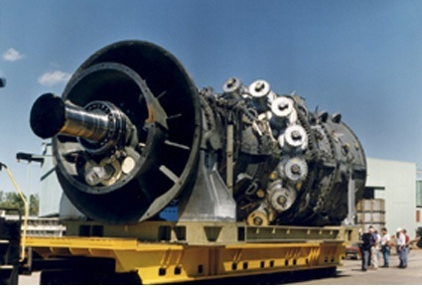
Decomposition Based System Design
Why decomposition based system design?
Some systems are difficult to solve;
Decomposition facilitates distributed design
http://www.aviationexplorer.com/boeing_787_rollout_photo.jpg
http://lh3.ggpht.com/_Y-PFNHJm1kc/Rxj99Wl915I/AAAAAAAAA7w/QyC6G-dpmZU/GasTurbine400MW.jpg
Notes:
Reasons for decomposition based design:
1, sometimes the computation process involves a number of engineering software, which makes the overall problem difficult to solve. Decomposing the original complex problem into several easier to solve subproblems is a good solution to such a situation.
2, some design tasks are collaborative in nature. Design engineers are divided into groups to accomplish the design of subsystems. An approach is needed to take care of this task so that the engineers effectively interact with each other and the optimum for the entire system can be achieved.

Slide 38
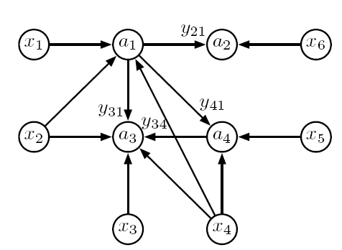
System decomposition
Example of a system to be decomposed:
System Equations:
Graph Representation:
Reference???
Notes:
A system is modeled as a group of design variables and analytical functions. When we mention “system”, usually we mean the system of variables and functions.

Slide 39
Trade-Off
[1]
There exists trade-off between partition size/number and coordination costs
Smaller partition size yields more coordination costs
Larger partition size yields less coordination costs
Notes:
The quantity of partitions, in addition to coupled sub-problems, increase the coordination computational costs of the analysis. The smaller the partition size is, more partitions exist to cover all the analyses, resulting in more coordination between all of the sub-problems. The larger the partition size is, less partitions are needed to cover all of the analyses, resulting in less coordination between sub-problems. In general, smaller sub-problems are computationally easier to solve, but the increased amount of sub-problems resulting from breaking up the problem increases the coordination tasks needed.

Slide 40
The P/C Problem
The Partitioning and Coordination (P/C) Problem:
Optimize the number, and therefore size of partitions needed, as well as the coordination problem size depending on a particular optimization problem
Four Methods to Solve the P/C Problem [1]
(P , C): Independently Solved
(P → C): P solved, then C
(C → P): C solved, then P
(P ║ C): P and C solved simultaneously
Only the fourth method provides all Pareto points to show tradeoff between coordination variables and partition size [1]
Notes:
The partitioning and coordination problem can then be defined as the problem of optimizing the number and size of partitions needed as well as the coordination problem size within a pre-chosen problem solution framework. There are 4 methods of approaching the solution of this problem. Solve P and C independently, solve for P first then for C, solve for C first and then for P, or solve P and C in parallel. Research has shown that solving in parallel yields all the pareto points for this multi-objective optimization problem which is to minimize partition size while minimizing coordination variables. There exists tradeoff here as we have defined in previous slides.

Slide 41
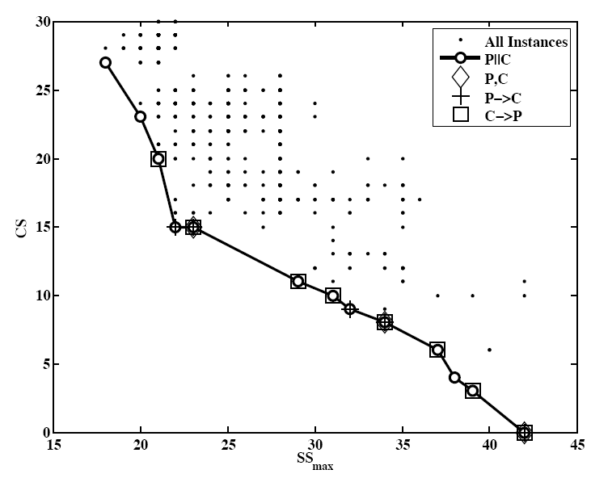
P/C Problem Example (Continued)
More Coordination
Variables
Less Coordination
Variables
Smaller Partitions,
Larger Quantity
Larger Partitions,
Smaller Quantity
Reference is missing!!!
Notes:
A quick example of the solution to this PC problem is shown above. It is clearly seen that a pareto curve exists between the aforementioned objectives. After further inspection it can be seen that the simultaneous solution of P and C covers all the pareto points, while the other methods may capture some, but not all of points on the pareto curve.

Slide 42
Example: Design of an Electric Vehicle
Notes:
A quick example to demonstrate the optimization of the structure of a decomposition based design problem follows. This is the design of an electric vehicle. 3 different subsystems are shown that are coupled to each other. How do we breakup the problem to solve it most efficiently?

Slide 43
Insightful Question
What are disjoint partitions of a system?
Answer:
Disjoint partitions refers to the groups of analytical functions and system variables such that: the functions are only dependent on the variables in the same set.
Examples: Identifying disjoint partitions in FDT
 | x1 | x2
f1
f2
f3
f4
Disjoint partition:
(f1,f3,x1);
(f2,f4,x2).
 | x1 | x2 | x3
f1
f2
f3
f4
Disjoint partition does not exist, unless x3 is ignored.
Notes:
“Disjoint partitions” represent partitioning decisions.
Usually, disjoint partitions do not exist unless some variables and analytical functions are deleted. In this case, such variables and functions would be taken as shared variables or coupling variables and be ignored when partitioning the system. The simplified system can be partitioned into “disjoint partitions” and form subsystems. Shared variables and coupling variables will be treated by the system coordination algorithm.

Slide 44
References
[1] James T. Allison. 'Optimal Partitioning and Coordination Decisions in Decomposition-based Design Optimization.' Ph.D. Dissertation, University of Michigan, 2008.
[2] James T. Allison, Panos Y. Papalambros. 'Practical Advances in Optimal System Design.' Graduate Student Symposium, University of Michigan, October 29th 2005, Ann Arbor, MI, USA.
[3] James T. Allison. 'Complex System Optimization: A Review of Analytical Target Cascading, Collaborative Optimization, and Other Formulations.' Master’s thesis, Department of Mechanical Engineering, University of Michigan, 2004.
[4] James T. Allison, Michael Kokkolaras, and Panos Y. Papalambros. 'Optimal Partitioning and Coordination Decisions in Decomposition-based Design Optimization.' In the Proceedings of the 2007 ASME Design Engineering Technical Conference DETC2007-34698. ASME, Sept. 4–Sept. 7 2007.
[5] Bryon Sohns, James T. Allison, Hosam Fathy, and Jeffrey L. Stein. 'Efficient Parameterization of Large-Scale Dynamic Models Through the Use of Activity Analysis.' In the Proceedings of the 2006 ASME International Mechanical Engineering Congress and Exposition, Chicago, Il, Nov 5-10 2006.
[6] James T. Allison. 'Design Optimization Model for an Automotive Electric Water Pump.' Technical Report, University of Michigan, Optimal Design Laboratory, 2007.
[7] James T. Allison. ‘Optimal Partitioning and Coordination Decisions in Decomposition-based Design Optimization.’ PhD Thesis, University of Michigan, Optimal Design Laboratory, 2008
[8] TC. Wagner, Panos Y. Papalambros, ‘A General Framework for Decomposition Analysis in Optimum Design’, Advances in Design Automation, vol.2, pp.315-325, 1993
http://www-personal.umich.edu/~jtalliso/publications.html

